Slide 1

Internship Project

Slide 2

Student Name : Maidam Shiva Kumar
Student ID :STU6571dacf1dafc1701960399
College Name :Vaagdevi Engineering College

Slide 3
CAPSTONE PROJECT SHOWCASE
Project Title : Energy Consumption using Power BI
Abstract | Problem Statement | Project Overview | Proposed Solution | Technology Used | Modelling & Results | Conclusion | Q&A

Slide 4
Abstract
This project leverages Power BI to analyze and visualize energy consumption data across multiple sectors, aiming to provide insights into usage patterns, efficiency improvements, and cost optimization. By integrating data from various energy sources, such as electricity, gas, and renewable energy, the system offers a comprehensive dashboard for tracking energy consumption trends. The visualizations facilitate the identification of areas with high consumption, anomalies, and opportunities for energy conservation. Power BI's advanced analytics and interactive reports enable decision-makers to take proactive measures for reducing energy costs, improving sustainability, and optimizing resource allocation. This project demonstrates the potential of data-driven insights in enhancing energy management practices for both commercial and residential applications.

Slide 5
Problem Statement
Efficient energy consumption management is a critical challenge for both residential and industrial sectors due to increasing energy demands, rising costs, and environmental concerns. Organizations and individuals often lack accessible tools to monitor, analyze, and optimize their energy usage effectively. The absence of real-time, data-driven insights leads to inefficiencies, higher operational costs, and missed opportunities for adopting sustainable practices.
This project addresses the need for a user-friendly, interactive solution to visualize energy consumption patterns, detect inefficiencies, and provide actionable insights for optimizing energy usage. By leveraging Power BI, the system aims to bridge the gap between raw energy data and strategic decision-making, promoting cost savings and sustainability.

Slide 6
Project Overview
The Energy Consumption project utilizes Power BI to create a comprehensive solution for analyzing and optimizing energy usage. The project integrates data from various energy sources, such as electricity, gas, and renewable energy, into an interactive dashboard that provides real-time insights into consumption patterns. Key metrics such as peak usage times, energy costs, and efficiency scores are visualized to aid users in understanding their energy behavior.
The system includes features like trend analysis, anomaly detection, and forecasting to identify inefficiencies and opportunities for cost and energy savings. By enabling users to drill down into specific data points and filter by time, location, or usage category, the tool supports informed decision-making. Additionally, the project promotes sustainability by helping users adopt energy-efficient practices based on data-driven recommendations.
This Power BI-based solution is designed for a wide range of users, including households, businesses, and energy providers, enabling them to achieve energy efficiency, reduce costs, and contribute to environmental conservation efforts.

Slide 7
Proposed Solution
The proposed solution is a Power BI-driven platform designed to analyze and visualize energy consumption data, enabling users to monitor, manage, and optimize their energy usage effectively. The solution involves the following key components:
Data Integration: Energy consumption data from multiple sources (e.g., electricity, gas, renewable energy systems) will be aggregated and cleaned for analysis. This includes real-time and historical data, sourced from IoT devices, smart meters, and utility reports.
Interactive Dashboards: Customized Power BI dashboards will present key performance indicators (KPIs) such as total energy usage, peak consumption periods, cost breakdowns, and energy efficiency ratings. Users can interact with charts, graphs, and tables to drill down into specific time frames, locations, or energy types.
Trend Analysis and Anomaly Detection: The system will identify consumption trends over time and detect anomalies or unexpected spikes in energy usage. This will help users understand patterns and address inefficiencies promptly.

Slide 8
Technology Used
Power BI:
Purpose: Core tool for data visualization and dashboard creation.
Usage: Interactive dashboards, trend analysis, anomaly detection, and forecasting energy consumption patterns.

Slide 9
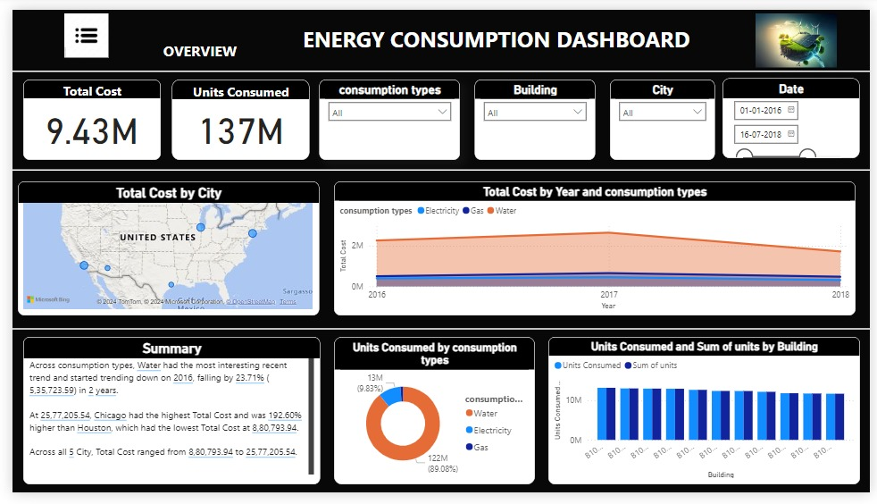
Modelling & Results
Overview Dashboard

Slide 10
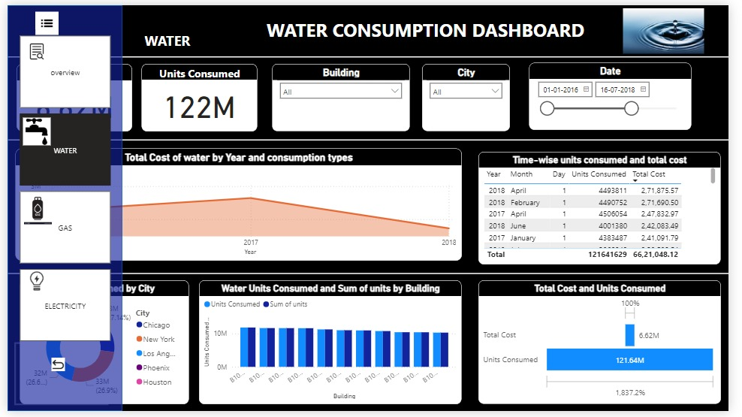
Modelling & Results
Water Dashboard with menu

Slide 11
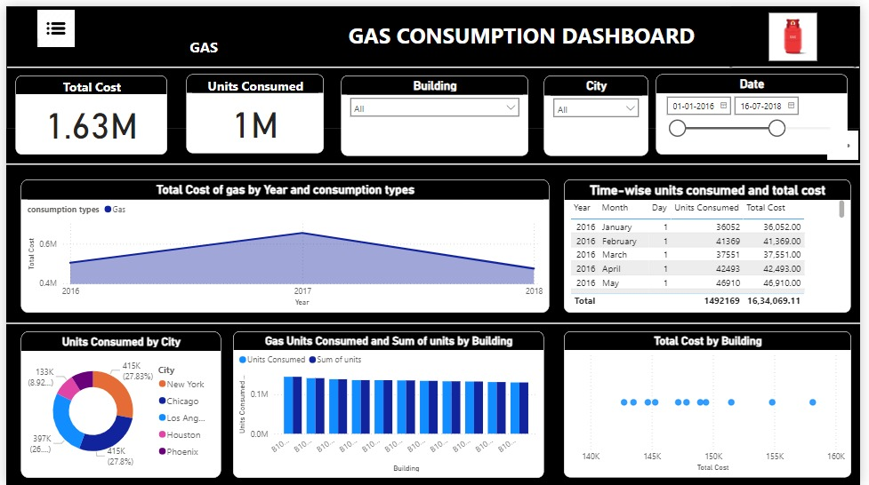
Modelling & Results
Gas Dashboard

Slide 12
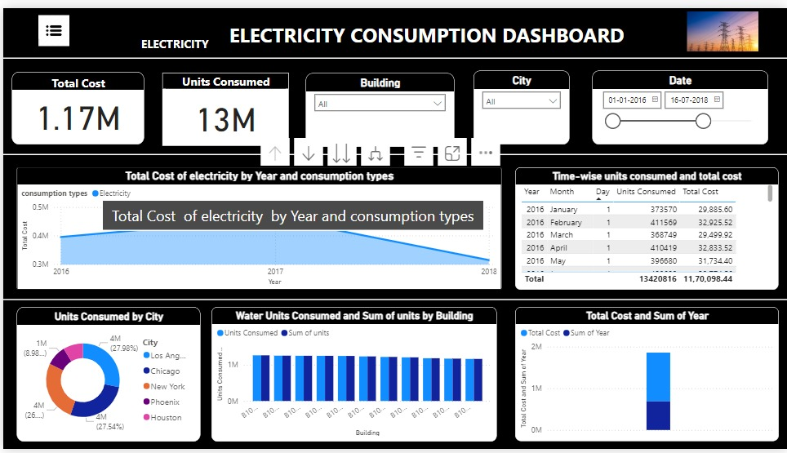
Modelling & Results
Electricity Dashboard

Slide 13
Conclusion
The Energy Consumption project demonstrates the power of data visualization and analytics in addressing modern energy management challenges. By leveraging Power BI, the solution provides a user-friendly platform for monitoring, analyzing, and optimizing energy usage. The interactive dashboards and advanced analytics empower users to identify inefficiencies, predict future consumption trends, and make data-driven decisions to reduce costs and environmental impact.
This project not only highlights the potential of integrating energy data from diverse sources but also emphasizes the importance of sustainability and energy efficiency in today’s world. The insights gained from the platform can drive strategic initiatives for energy conservation and promote a shift toward greener practices in both residential and commercial sectors.
In conclusion, this Power BI-based energy consumption analysis tool is a practical and impactful solution for fostering informed decision-making, enabling users to save resources while contributing to a more sustainable future.

Slide 14
Thank You!
Notes:
Thank You !!

